Slide 1
Discussion 10
Iterators, Generators, Streams
Jason Zhou | Section 136
CS61A Spring 2019

Slide 2
Announcements
Today: Lab 11 Due
HW 09 Due
Tuesday: Scheme +1 EC
Wednesday: Scheme Full Project

Slide 3
Agenda
Iterators & Generators
Streams

Slide 4
Iterables & Iterators
Reminder:
Data Types: Lists, Tuples, Strings, Dictionaries
All various collections of values
Can iterate through these values using a for loop
i.e. [x for x in lst]
Iteration:
Process each individual value, in a collection of values
Sequentially
Order matters
One at a time
for loop extracts a single value from a given collection

Slide 5
Iterables & Iterators
Iterable:
any data type that is a collection of values, that can be iterated through
i.e. lists, tuples, dictionaries, strings (a collection of characters), etc.
Today:
inner-workings of iteration (for loops)
Example:
lst = [1, 2, 3, 4]
for x in lst:
print(x)

Slide 6
Iterables & Iterators
lst
1 | 2 | 3 | 4
Example:
lst = [1, 2, 3, 4]
for x in lst:
print(x)
Terminal Output:

Slide 7
Iterables & Iterators
lst
1 | 2 | 3 | 4
Example:
lst = [1, 2, 3, 4]
for x in lst:
print(x)
Terminal Output:
1

Slide 8
Iterables & Iterators
lst
1 | 2 | 3 | 4
Example:
lst = [1, 2, 3, 4]
for x in lst:
print(x)
Terminal Output:
1
2

Slide 9
Iterables & Iterators
lst
1 | 2 | 3 | 4
Example:
lst = [1, 2, 3, 4]
for x in lst:
print(x)
Terminal Output:
1
2
3

Slide 10
Iterables & Iterators
lst
1 | 2 | 3 | 4
Example:
lst = [1, 2, 3, 4]
for x in lst:
print(x)
Terminal Output:
1
2
3
4

Slide 11
Iterables & Iterators
When a for loop is applied to some iterable lst:
(i.e. for x in lst)
Python calls iter(lst)
iter(lst) returns an iterator
iterator is the arrow/marker
Points initially to the beginning of lst
Marks iteration progress
Python calls next(iterator)
advances the arrow by 1 spot
returns value at old spot
Python repeatedly calls next(iterator) until arrow advances past the end of lst
lst
1 | 2 | 3 | 4

Slide 12
Iterables & Iterators
Example:
>>> lst = [1, 2, 3, 4]
>>> lst_iterator = iter(lst)
lst
1 | 2 | 3 | 4

Slide 13
Iterables & Iterators
Example:
>>> lst = [1, 2, 3, 4]
>>> lst_iterator = iter(lst)
>>> next(lst_iterator)
lst
1 | 2 | 3 | 4

Slide 14
Iterables & Iterators
Example:
>>> lst = [1, 2, 3, 4]
>>> lst_iterator = iter(lst)
>>> next(lst_iterator)
1
lst
1 | 2 | 3 | 4

Slide 15
Iterables & Iterators
Example:
>>> lst = [1, 2, 3, 4]
>>> lst_iterator = iter(lst)
>>> next(lst_iterator)
1
>>> next(lst_iterator)
2
lst
1 | 2 | 3 | 4

Slide 16
Iterables & Iterators
Example:
>>> lst = [1, 2, 3, 4]
>>> lst_iterator = iter(lst)
>>> next(lst_iterator)
1
>>> next(lst_iterator)
2
>>> next(lst_iterator)
3
lst
1 | 2 | 3 | 4

Slide 17
Iterables & Iterators
Example:
>>> lst = [1, 2, 3, 4]
>>> lst_iterator = iter(lst)
>>> next(lst_iterator)
1
>>> next(lst_iterator)
2
>>> next(lst_iterator)
3
>>> next(lst_iterator)
4
>>> next(lst_iterator)
StopIteration
lst
1 | 2 | 3 | 4

Slide 18
Iterables & Iterators
Example 2:
>>> str = “abc”
>>> str_iterator = iter(str)
str
a | b | c

Slide 19
Iterables & Iterators
Example 2:
>>> str = “abc”
>>> str_iterator = iter(str)
>>> next(lst_iterator)
str
a | b | c

Slide 20
Iterables & Iterators
Example 2:
>>> str = “abc”
>>> str_iterator = iter(str)
>>> next(lst_iterator)
‘a’
str
a | b | c

Slide 21
Iterables & Iterators
Example 2:
>>> str = “abc”
>>> str_iterator = iter(str)
>>> next(lst_iterator)
‘a’
>>> next(lst_iterator)
‘b’
str
a | b | c

Slide 22
Iterables & Iterators
Example 2:
>>> str = “abc”
>>> str_iterator = iter(str)
>>> next(lst_iterator)
‘a’
>>> next(lst_iterator)
‘b’
>>> str_iterator_2 = iter(str)
str
a | b | c

Slide 23
Iterables & Iterators
Example 2:
>>> str = “abc”
>>> str_iterator = iter(str)
>>> next(lst_iterator)
‘a’
>>> next(lst_iterator)
‘b’
>>> str_iterator_2 = iter(str)
str
a | b | c

Slide 24
Iterables & Iterators
Example 2:
>>> str = “abc”
>>> str_iterator = iter(str)
>>> next(lst_iterator)
‘a’
>>> next(lst_iterator)
‘b’
>>> str_iterator_2 = iter(str)
>>> next(str_iterator_2)
str
a | b | c

Slide 25
Iterables & Iterators
Example 2:
>>> str = “abc”
>>> str_iterator = iter(str)
>>> next(lst_iterator)
‘a’
>>> next(lst_iterator)
‘b’
>>> str_iterator_2 = iter(str)
>>> next(str_iterator_2)
‘a’
str
a | b | c

Slide 26
Iterables & Iterators
Example 2:
>>> str = “abc”
>>> str_iterator = iter(str)
>>> next(lst_iterator)
‘a’
>>> next(lst_iterator)
‘b’
>>> str_iterator_2 = iter(str)
>>> next(str_iterator_2)
‘a’
>>> next(str_iterator)
str
a | b | c

Slide 27
Iterables & Iterators
Example 2:
>>> str = “abc”
>>> str_iterator = iter(str)
>>> next(lst_iterator)
‘a’
>>> next(lst_iterator)
‘b’
>>> str_iterator_2 = iter(str)
>>> next(str_iterator_2)
‘a’
>>> next(str_iterator)
‘c’
str
a | b | c

Slide 28
Iterators & Iterables
Iterators
iter(iterable) to obtain iterator
next(iterator) to obtain next element
Repeatedly call next(iterator) to output all elements
Errors when out of elements to output
Note:
Alternate definition of iterable: any object that implements __iter__()
Can call iter() on iterators
This makes iterators iterables
iter(iterator) to get the exact same iterator back
i.e. the exact same arrow/position

Slide 29
Generators
Generators
Using keyword yield inside a function turns it into a generator
Calling a generator function returns an iterator
return vs. yield
When next(iterator) is called, iterator runs the body of the function...
...until first yield statement
pauses until next(iterator) is called again
…runs until next yield statement
etc.

Slide 30
Generators
iter(), next(), messy
Usually encapsulated by for semantics
Defining our own iterables/iterators cleanly
Reminder:
return keyword: when reached, stop execution of a function, return value
yield keyword:
When reached, stop execution of a function, return value
Next time the function is called:
Start execution at line after last yield

Slide 31
Iterators & Generators
Generators
A function that uses the yield keyword
Calling a generator function returns a generator object
Generator object: a type of iterator
Can call next() on generator object to get next value
Functions identically to normal iterators
Except we can define their behaviour

Slide 32
Iterators & Generators
Generator Example:
Want a generator function that yields all even numbers, from 0 to 100.
def even_generator():
x = 0
while x <= 100:
yield x
x += 2
>>> g = even_generator()
>>> next(g)
0
>>>next(g)
2

Slide 33
Iterators & Generators
yield from:
yield from some_iterable shorthand for:
for x in some_iterable:
yield x
def even_generator():
even_numbers = [x for x in range(101) if x % 2 == 0]
yield from even_numbers

Slide 34
Streams

Slide 35
Streams
In CS, space/storage/memory always a concern
Ex. Tail recursion
How can we represent an infinitely long sequence?
Using defined rules to calculate every element of a given sequence
Fib(0) = 0, Fib(1) = 1
Fib(x) = Fib(x - 1) + Fib(x - 2)
How can we represent infinitely long sequences in Python?
Iterators/Generators that implement the defined rules of a given sequence

Slide 36
Streams
def infinite_evens():
x = 0
while True:
yield x
x += 2
Scheme: No iterators/generators
Streams

Slide 37
Streams
Example:
natural(n): an infinitely long list of increasing natural numbers starting at x
natural(1) : [1, 2, 3, 4, ….]
natural(1): [1, natural(2)]
Generalizing naturals(n):
naturals(1): [1, 2, 3, 4 …] = [1, naturals(2)]
naturals(n): [n, n+1, n+2 … ] = [n, naturals(n+1)]

Slide 38
Streams
naturals(n): [n, n+1, n+2 … ] = [n, naturals(n+1)]
Infinitely long list: stream
Can be written as just a list with 2 elements
First element: the first value in the stream
Second element: another stream (called a promise)
(cons-stream operand1 operand2)
(define (naturals n) (cons-stream n (naturals (+ n 1))))
(cons-stream operand1 operand2)
Operand 1: first element of the stream
Operand 2: the rest of the stream, which is another stream

Slide 39
Streams Semantics
Lazy Evaluation
The rest of the stream is not calculated until it is asked for
A promise is not evaluated until it is forced
scm> (define (naturals n) (cons-stream n (naturals (+ n 1))))
naturals
scm> (naturals 1)
(1 . #[promise (not forced)])

Slide 40
Streams Semantics
To force a promise / to get the rest of the stream:
(cdr-stream some_stream)
scm> (define (naturals n) (cons-stream n (naturals (+ n 1))))
scm> (define our-stream (naturals 1))
scm> our-stream
(1 . #[promise (not forced)])
scm> (car our-stream)
1
scm> (cdr our-stream)
#[promise (not forced)]
scm> (cdr-stream our-stream)
(2 . #[promise (not forced)])
scm> (car (cdr-stream our-stream))
2
scm> our-stream
(1 . #[promise (forced)])

Slide 41
Streams Semantics
Memoization
Store the result of a past calculation to avoid re-calculation in the future
A promise that has been forced will not be re-evaluated
When an element of the stream has been calculated
It is simply stored and returned when asked for again
It is not re-calculated, even if the stream is re-defined/changed

Slide 42
Streams Semantics
scm> (define (naturals n) (cons-stream n (naturals (+ n 1))))
scm> (define our-stream (naturals 1))
scm> our-stream
(1 . #[promise (not forced)])
scm> (cdr-stream our-stream)
(2 . #[promise (not forced)])
scm> (cdr-stream (cdr-stream our-stream))
(3 . #[promise (not forced)])
scm> (define (naturals n) (cons-stream n (naturals (* n 2)))
scm> (cdr-stream (cdr-stream (cdr-stream our-stream)))
(4 . #[promise (not forced)])
scm> (cdr-stream (cdr-stream (cdr-stream (cdr-stream our-stream))))
(8 . #[promise (not forced)])
scm> our-stream
(1 . #[promise (forced)])
scm> (cdr-stream our-stream)
(2 . #[promise (forced)])
scm> (cdr-stream (cdr-stream our-stream))
(3 . #[promise (forced)])

Slide 44
Attendance
links.cs61a.org/jasonz-attendance

Slide 46
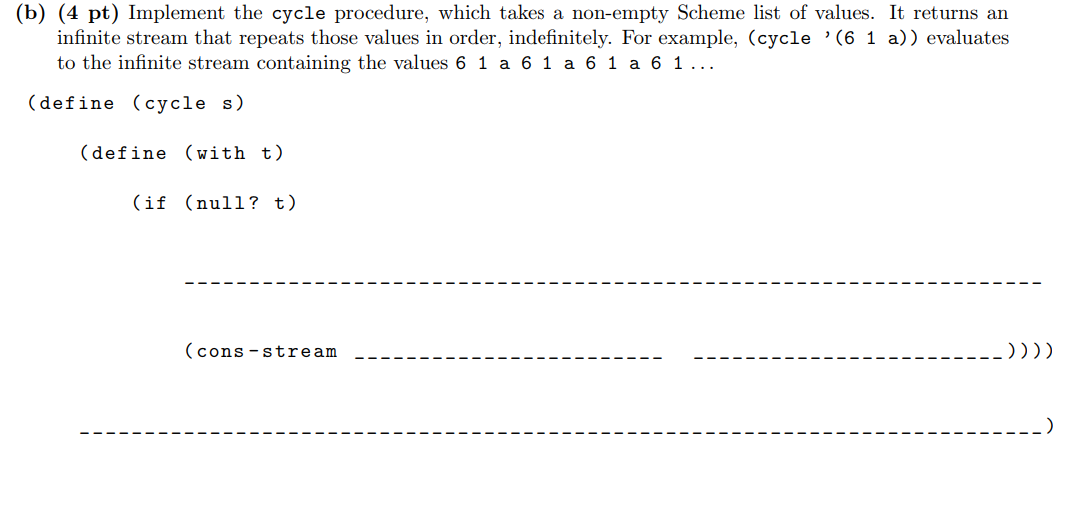

Slide 47
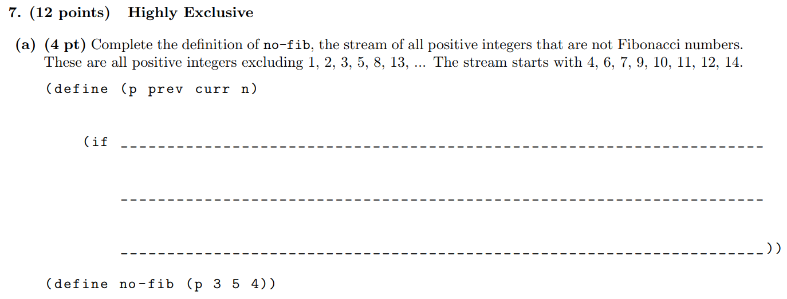

Slide 48
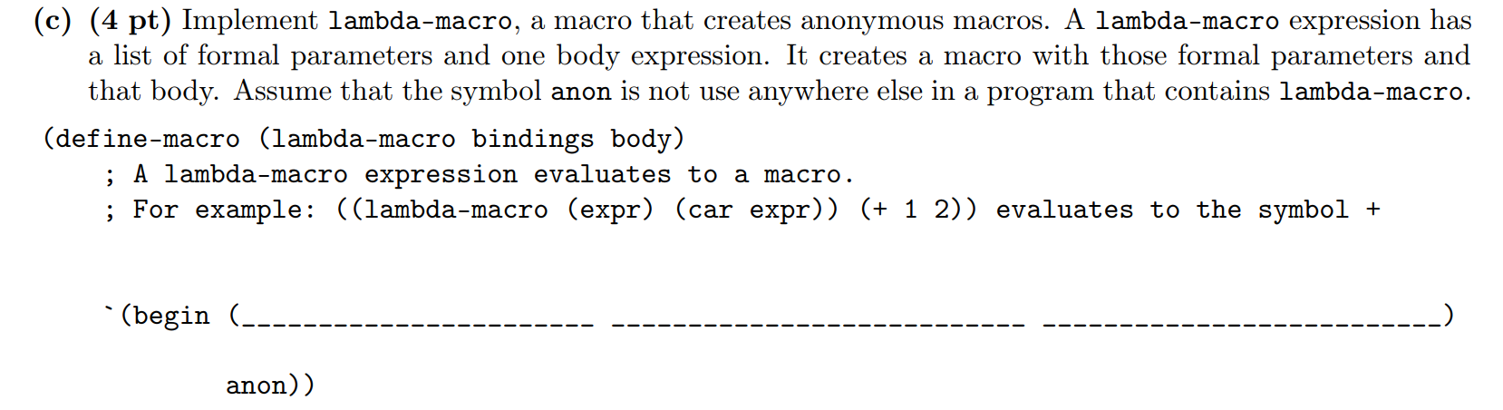

Slide 49
Macros
Allows user-defined shorthands
Macroinstructions
Approach: build a “string” representation of code to be executed
Syntax: (define-macro (name operand1 operand2 …) body)
Evaluation:
Evaluate operator (to see that we have a macro form)
Apply operator to unevaluated operands (quote operands)
Evaluate returned expression in frame macro was called in

Slide 50
Macros
Problem: Want a macro that, given an expression called “f”, executes “f” twice.
Approach: build a “string” representation of code to be executed
Given expression “f”, code to be executed: (begin f f)
(begin f f) is a list
First element: the word/string literal “begin”
Second & third elements: the expression referred to by “f”
Not the string “f” literally

Slide 51
Build the string: (“begin” f f)
Approach 1: Evaluate everything except the word “begin”, then put into a list
Put [‘begin] [f] [f] into a list
Solution 1: (list ‘begin f f)
Approach 2: Do not evaluate anything except “f” “f”, then put into a list
`(begin ,f ,f)
Quasi-quoting: ` states “do not evaluate anything except those with ,”
, states “evaluate the following expression”
‘ states “do not evaluate anything in the following expression”

